Slide 1

INTRODUCTION TO COMPUTERS
ACIT STUDENTS

Slide 2
CONTENT
INTRODUCTION
BRANDS OF COMPUTER
PARTS OF COMPUTER
TYPES OF COMPUTER
1
2

Slide 3
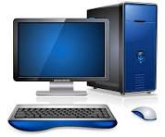
COMPUTERS
AN ELECTRONIC DEVICE WHICH TAKES INPUT , PROCESS IT AND PROVIES US USEFUL INFORMATION AS OUTPUT
INPUT
PROCESS
OUTPUT

Slide 4
PARTS OF COMPUTER
SOFTWARE
HARDWARE

Slide 5
SOFTWARE
SOFTWARE TYPES
SYSTEM SOFTWARE
APPLICATION SOFTWARE

Slide 6
HARDWARE
KEYBOARD (INPUT )
MOUSE (INPUT)
SCANNER (INPUT)
SPEAKER (OUTPUT)
MONITER (OUTPUT)
PRINTER (OUTOUT)

Slide 7
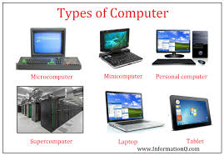
TYPES OF COMPUTERS
LAPTOP
HENDHELD
MAIN FRAME
DESKTOP

Slide 8
COMPUTER BRANDS
HP 17.8
DELL 16
LENOVO 18

Slide 9
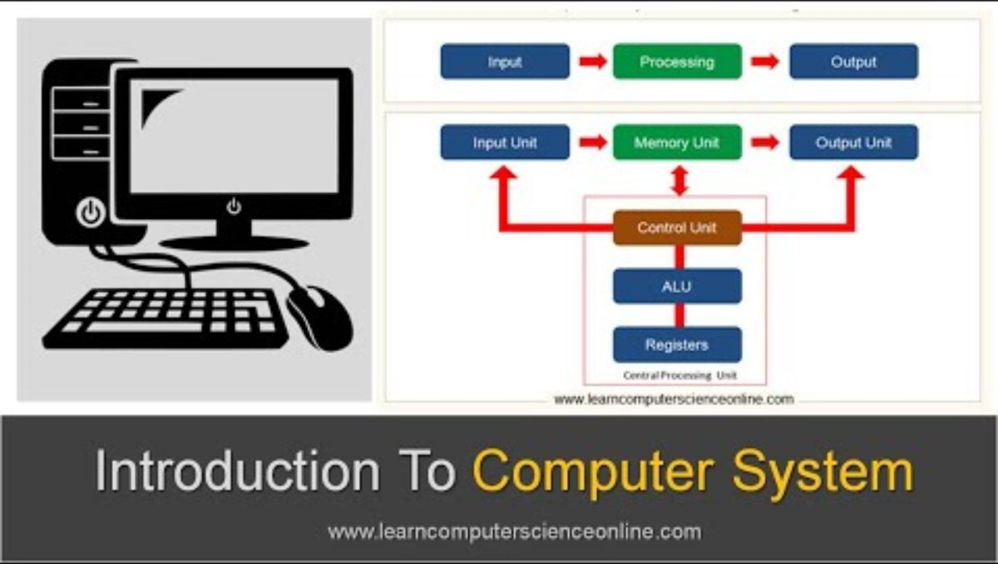
INTRODUCTION TO COMPUTERS

Slide 10
SHORT DEFINATIONS OF COMPUTERS

Slide 11
THANK YOU

